Slide 1

FlightFinder - Flight Search & Booking App
Team ID : LTVIP2025TMID43395
Team Size : 4
Team Leader : Bharathi Madiki
Team member : Pabolu Sudheer
Team member : Paina Durga Syamalarao
Team member : Pangam Satwika
College name:
Aditya college of engineering & technology, surampalem

Slide 2
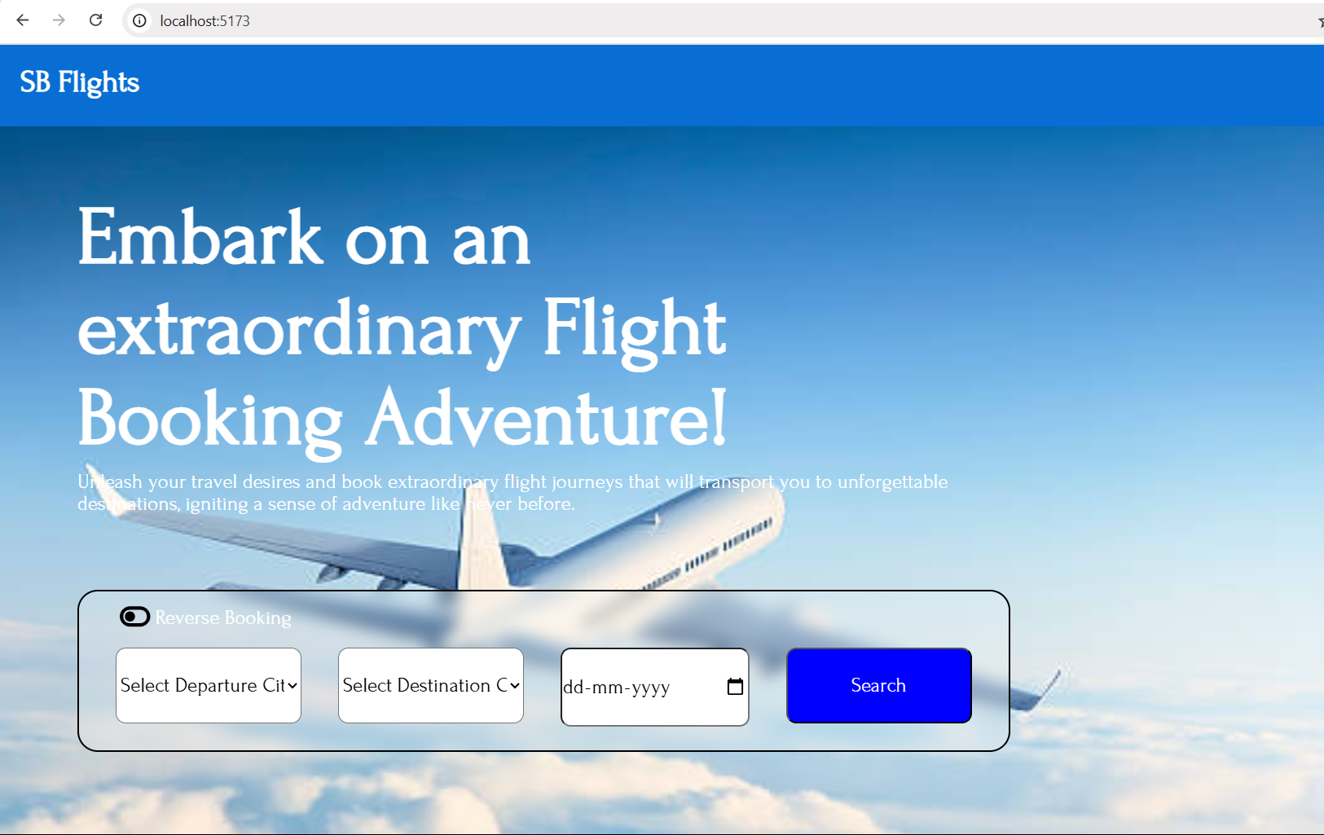
Problem Statement
Difficulty in searching and booking flights
Lack of user-friendly platforms
Operators struggle to manage flights/bookings
Admins lack central control

Slide 3
Proposed Solution
Web-based flight search and booking system
Separate dashboards for users, operators, admins
Secure authentication (JWT)
Centralized flight and booking management

Slide 4
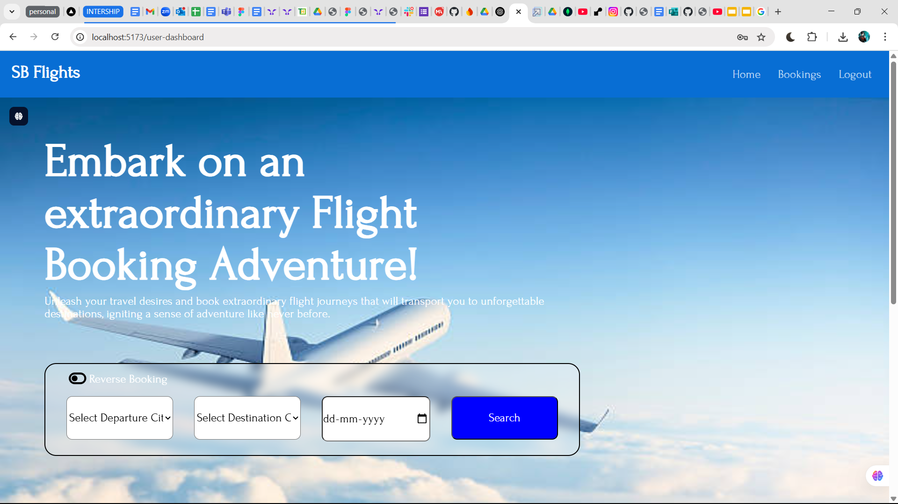
Key Features - User
Register/Login
Flight Search & Booking
Add Passenger Details
View Booking History

Slide 5
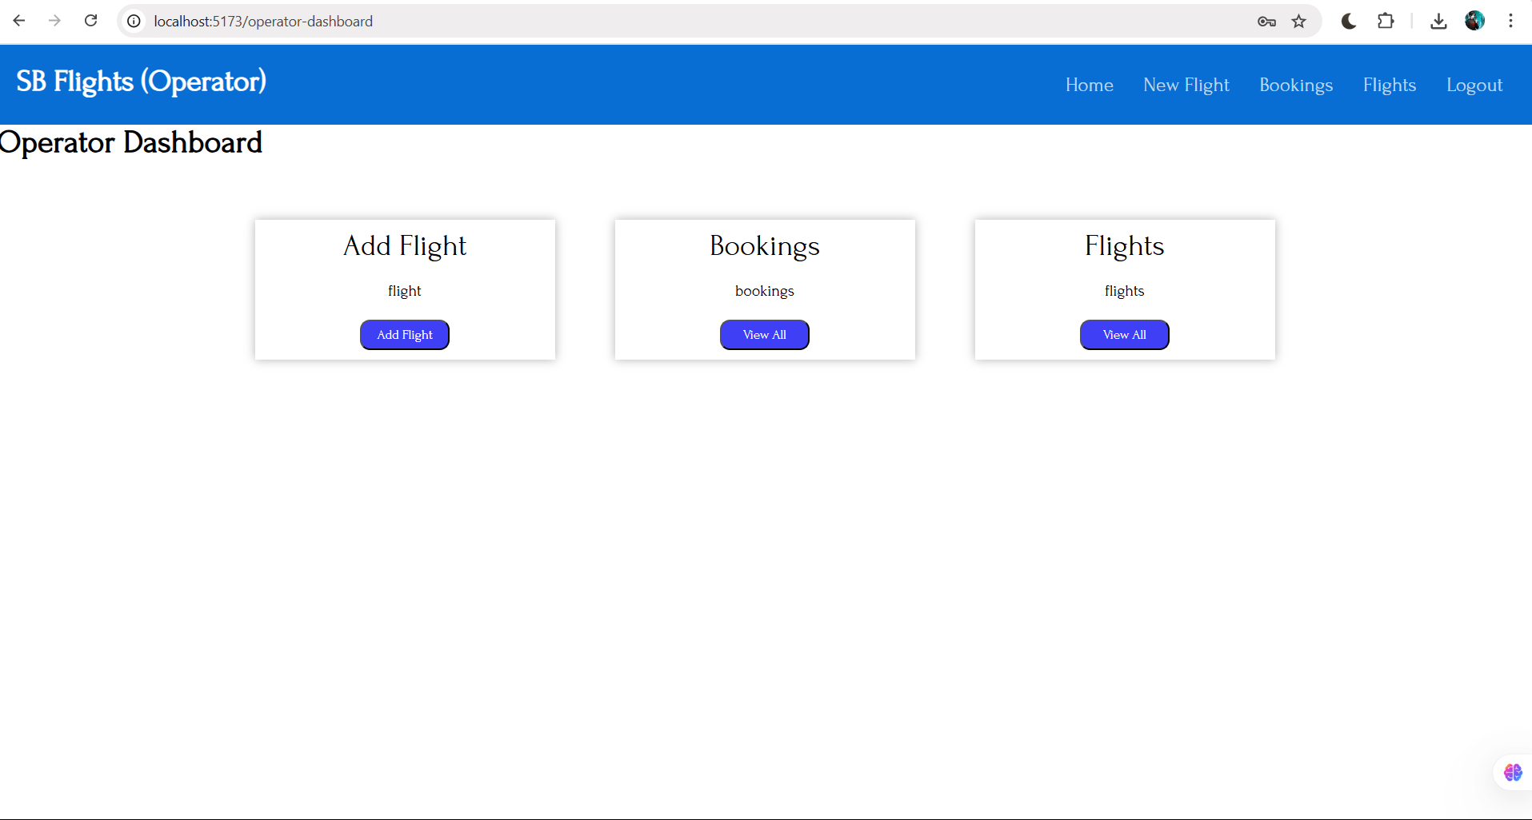
Key Features - Operator
Add Flights
View Added Flights
View Bookings
Requires Admin Approval

Slide 6
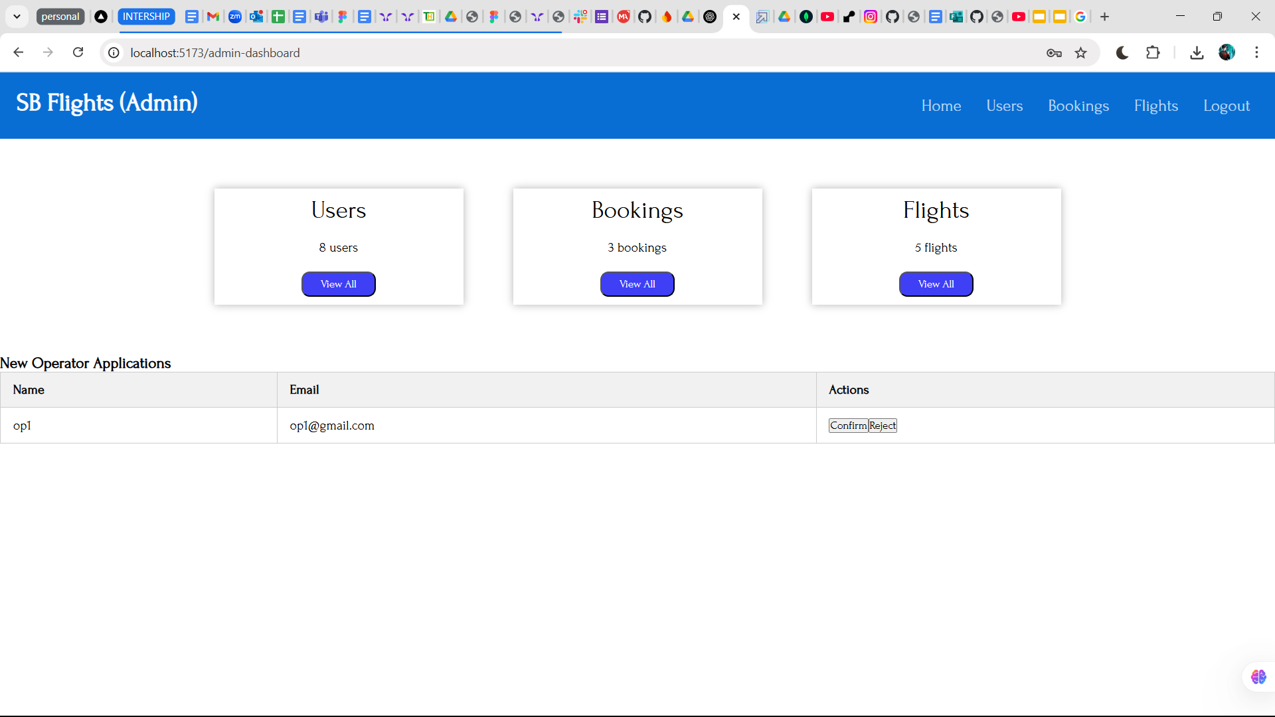
Key Features - Admin
Approve/Reject Operators
Manage Users and Operators
View All Flights
View All Bookings

Slide 7
Technologies Used
Frontend: React.js, CSS
Backend: Node.js, Express.js
Database: MongoDB
Authentication: JWT
Hosting: Vercel (Frontend), Render (Backend)

Slide 8
Future Scope
Payment Integration
Email Notifications
Advanced Seat Selection
Profile & History Management

Slide 9
Conclusion
Solves real-world flight booking issues
Secure, scalable & user-role based
Ready for production and future features
Thank You…

